Slide 1
The event will begin momentarily.
This event is being recorded
Captions are available by clicking the CC icon in the Zoom toolbar below
ASL is provided
Presentation materials are available at:
www.access-board.gov

Slide 2
Moving Forward: Access to Inclusive Fitness Equipment
July 14, 2021

Slide 3

Next presenter…

Slide 4
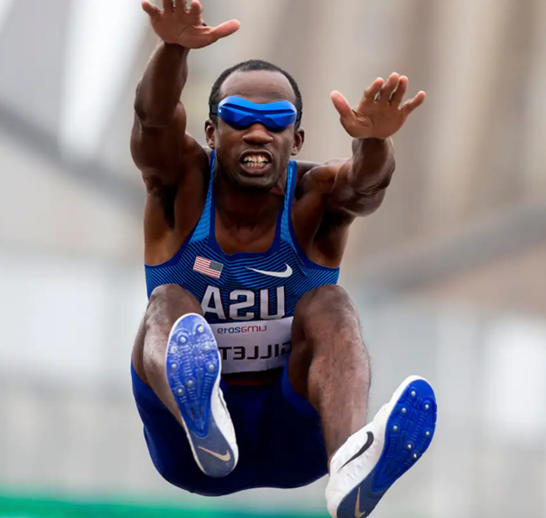
Lex Gillette
Paralympian

Slide 5
Next presenter…

Slide 6
Panel 1 Need for Inclusive Fitness Equipment
Kelly Bonner
National Center on Health, Physical Activity and Disability (NCHPAD) / Lakeshore
Clark Rachfal
American Council for the Blind (ACB)

Slide 7
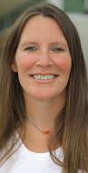
Kelly Bonner
Associate Director of NCHPAD
Certified Inclusive Fitness Trainer- ACSM
Certified Personal Trainer- ACE

Slide 8

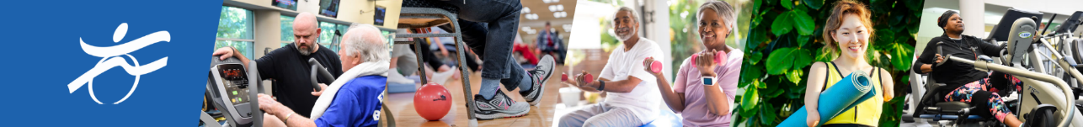
Why Inclusion is Important

Slide 9
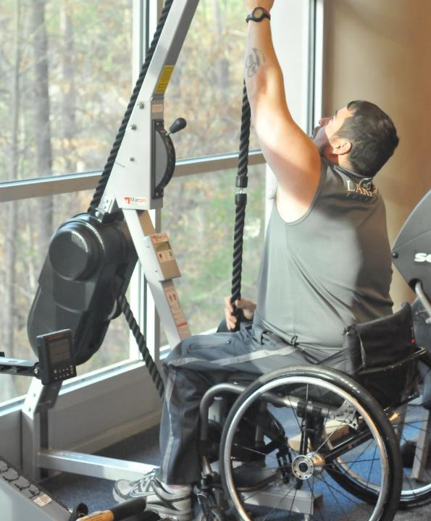
Equity
Equal opportunities to participate
What the pandemic taught us

Slide 10

Inclusion Means
To transform communities based on social justice principles in which all community members:
Are presumed competent
Are recruited and welcome as valued members of their community
Fully participate and learn with their peers
Experience reciprocal social relationships.

Slide 11
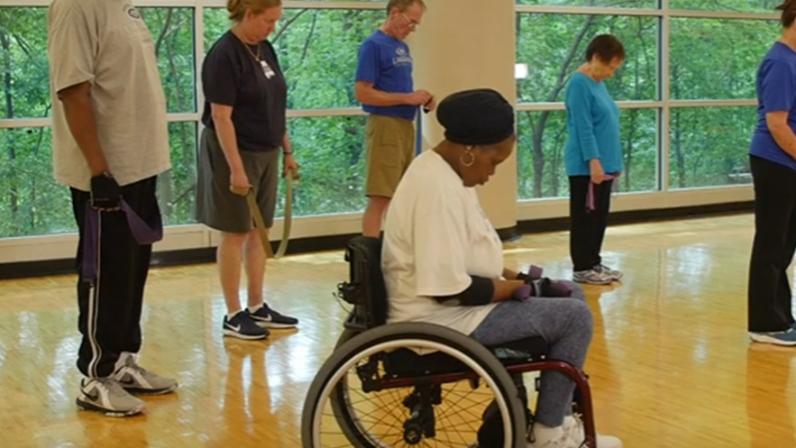

Current State of Health

Slide 12
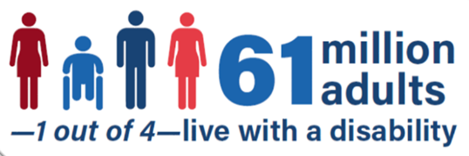
Disability Impact
Disability is especially common in older adults, women and minorities.
2 in 5 adults age 65 years and older have a disability
1 in 4 women have a disability.
2 in 5 non-Hispanic American Indians/ Alaska Natives have a disability.

Slide 13
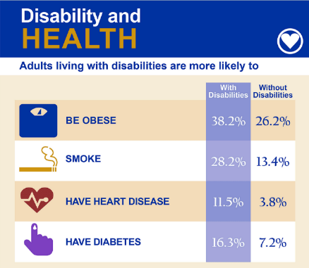
Disability Impacts All of Us
Adults with disabilities are 2-3 times more likely to have heart disease, stroke, diabetes, or cancer than adults without disabilities
60% of all adults with disabilities get no aerobic physical activity, an important health behavior to help avoid these chronic diseases
38% higher obesity rates for youth with a disability
Disability is a health disparity NOT a health outcome!

Slide 14
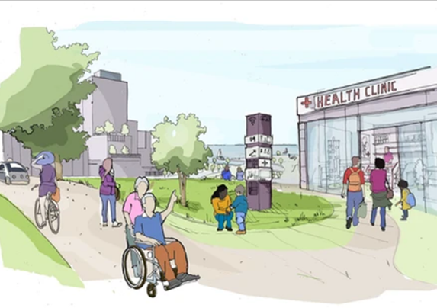
Health of People with Disability
Poor health epidemic
Inactivity and sedentary lifestyles
Misconceptions and oversight
Lack of health promotion
Lack of information, training, and resources

Slide 15
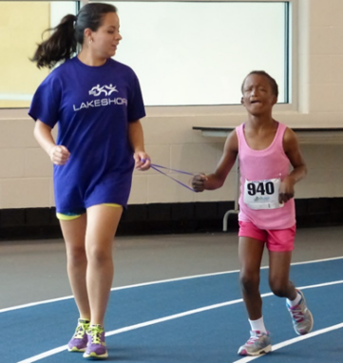
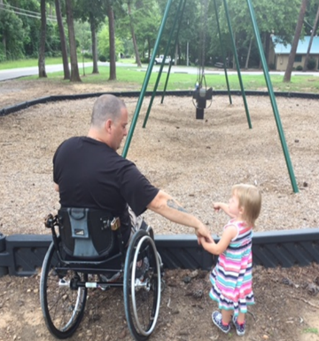
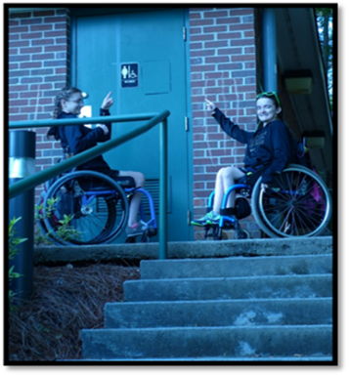

Barriers to Physical Activity
Programmatic
Attitudinal
Architectural

Slide 16
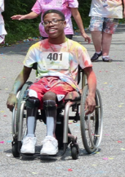
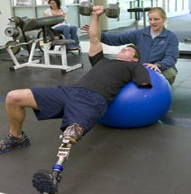
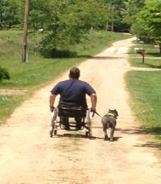
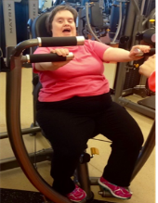
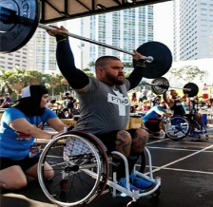
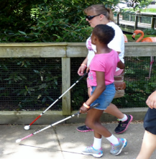
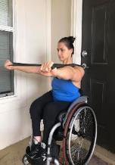
National Center on Health, Physical Activity and Disability
Founded in 1999, NCHPAD is a public health practice and resource center for information on physical activity, health promotion, and disability, serving persons with physical, sensory and cognitive disability across the lifespan.
Funded National Center on Disability from the Centers for Disease Control and Prevention, National Center on Birth Defects and Developmental Disabilities (NCBDDD)
Operates within the UAB/Lakeshore Foundation Research Collaborative

Slide 17
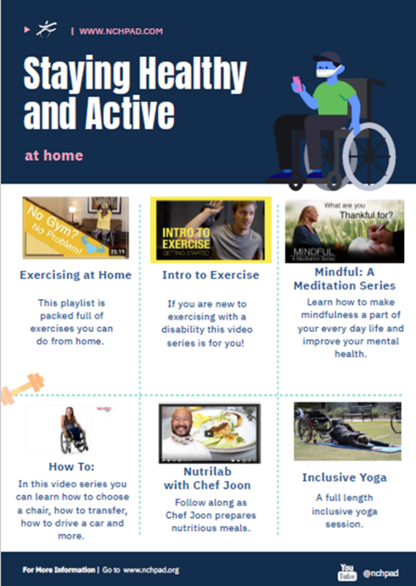
Resources
www.nchpad.org

Slide 18
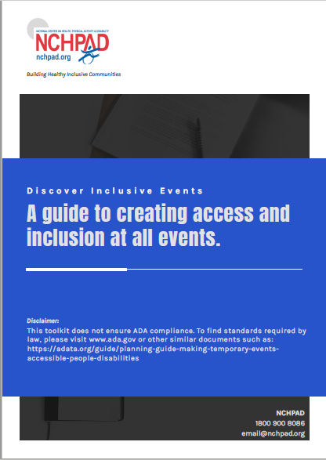
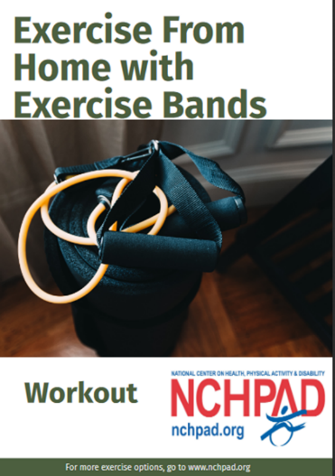
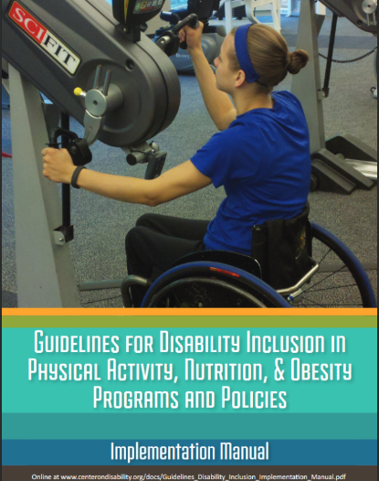
NCHPAD

Slide 19
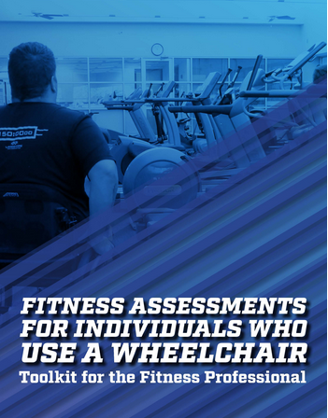
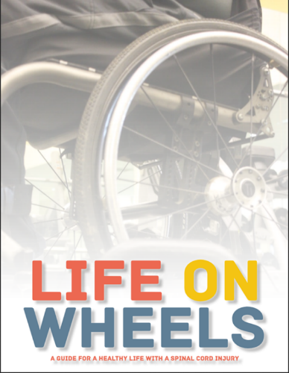
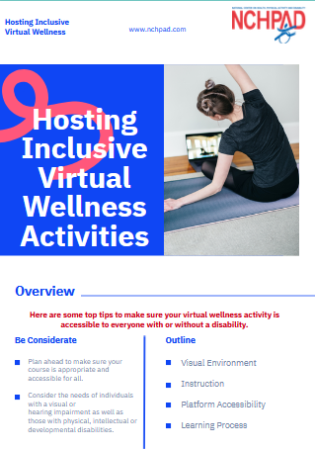
NCHPAD RESOURCES

Slide 20
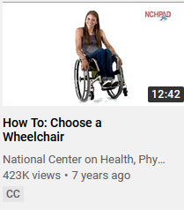
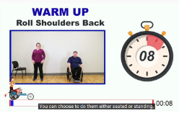
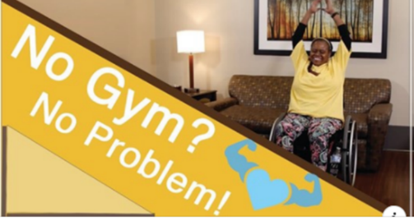
YouTube
Inclusive meditations
Inclusive fitness
How to video series
Nutrition
Intro to Exercise
Much more

Slide 21
Next presenter…

Slide 22
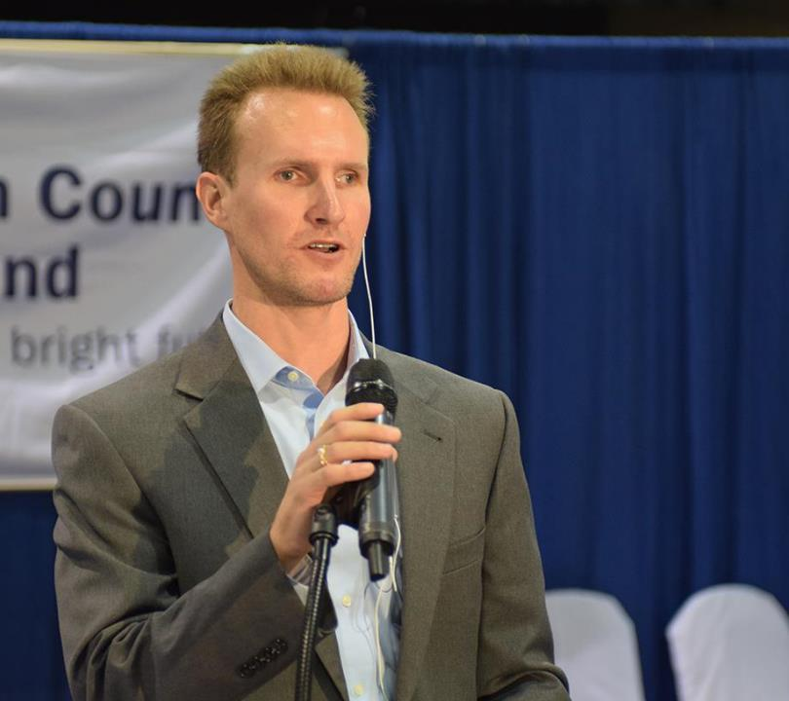
Clark Rachfal
Director of Advocacy and Governmental Affairs
American Council of the Blind (ACB)

Slide 23
QUESTIONS?
You may type and submit questions in the Q&A Area

Slide 24
Next presenter…

Slide 25
Panel 2: Ongoing Inclusive Fitness Initiatives
Bill Botten
US Access Board
Dr. Stephanie Schnorbus Stephens
Beneficial Designs Inc. / RESNA – Inclusive Fitness
Richard Thesing
Mobility Fitness / ASTM
Dr. Elizabeth Barstow
Sangeetha Padalabalanarayanan
University of Alabama at Birmingham

Slide 26
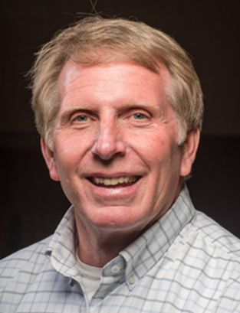
Bill Botten Training Coordinator US Access Board

Slide 27
Americans with Disabilities Act (ADA)
Architectural Barriers Act (ABA)
Minimum Requirements

Slide 28
Types of Facilities Covered
Health club, gym, fitness facility, training studio
Employee fitness facilities
Professional sports team training facilities
Fitness facilities connected with a hotel/motel, resort, airport, spa
Local recreation centers, YMCA
Education facilities, colleges
Outdoor fitness facilities
ADA – STATE AND LOCAL GOVERNMENT FACILITIES, PLACES OF PUBLIC ACCOMODATION, COMMERCIAL FACILITIES
ABA – FEDERALLY FUNDED FACILITIES

Slide 29
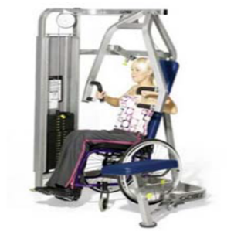
§236 - Exercise Machines and Equipment
§236.1 General
At least one of each type of exercise machine and equipment shall comply with §1004.
Advisory: Most strength training equipment and machines are considered different types. Where operators provide a biceps curl machine and cable-cross-over machine, both machines are required to meet the provisions in this section, even though an individual may be able to work on their biceps through both types of equipment.
Similarly, there are many types of cardiovascular exercise machines, such as stationary bicycles, rowing machines, stair climbers, and treadmills. Each machine provides a cardiovascular exercise and is considered a different type for purposes of these requirements.

Slide 30
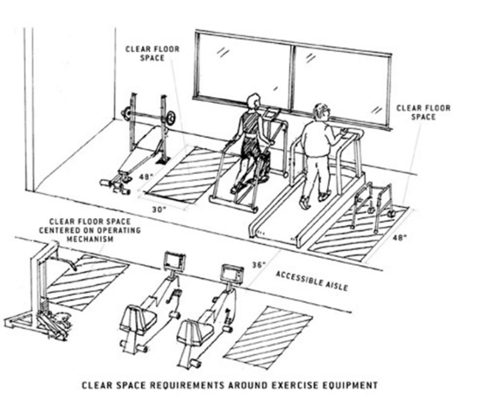
§1004 - Exercise Equipment and Machines
§1004.1 Clear Floor Space
Exercise machines and equipment shall have a clear floor space complying with §305 positioned for transfer or for use by an individual seated in a wheelchair.

Slide 31
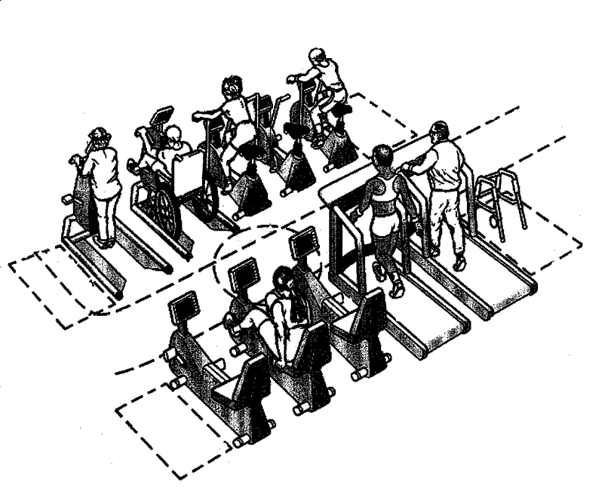
Exercise Equipment and Machines
30” x 48” clear space and connecting accessible route
Positioned for use by an individual using a mobility device
Clear floor space or ground space for more than one piece of equipment can overlap

Slide 32
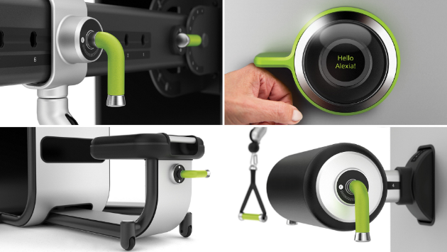
Operable Parts §205.1 (Exception 8)
Exercise machines and exercise equipment shall not be required to comply with requirements for operable parts (§309).
Includefitness.com

Slide 33
Further Information
U.S. Access Board
ta@access-board.gov
www.access-board.gov
(800) 872-2253 (voice)
(800) 993-2822 (TTY)

Slide 34
Next presenter…

Slide 35
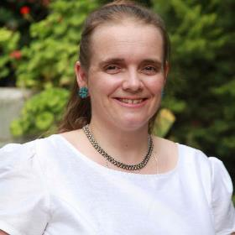
Moving Forward: Access to Inclusive Fitness Equipment—
RESNA IF: Writing Standards for Fitness Facilities
Stephanie Schnorbus Stephens, Ph.D.
Beneficial Designs, Inc. Minden, Nevada

Slide 36
Standards: Bridging the Gap
Created by balanced committees
Can be mandatory or voluntary
Translate requirements into practice
Provide instructions, objective specifications, and test methods
Can provide best practices
Help implement laws and mandates to improve access

Slide 37
Standards: Bridging the Gap
ADA covers the built environment
But once parked and inside a public fitness facility,
What does a person with a disability have access to?

Slide 38
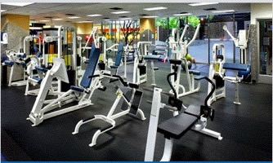
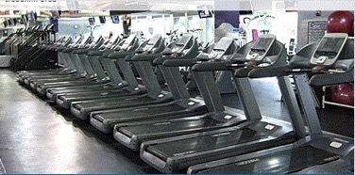
The Gap Illustrated
Can’t negotiate safely around or on/off equipment
Give up?
Or risk injury?

Slide 39
The Gap Illustrated
Staff and trainers experienced with disability
Inclusive programming
Inclusive environment
All almost nonexistent

Slide 40
Inclusive Fitness Fitness in the Community
Specialized medical therapy settings
No family and friends
Travel burden
Under treatment/insurance
Inclusive fitness means fitness in the local community

Slide 41
Inclusive Fitness Momentum
2012, RESNA Standards Committee on Inclusive Fitness
Consolidate best practice to increase access for people of all abilities and the aging
Enable benchmarking, action planning, and progress monitoring of accessibility
Reframe the language of “access” to “universal design” and “inclusive”
Allow people with disabilities to identify centers meeting their needs

Slide 42
So what does it mean to be inclusive?

Slide 43
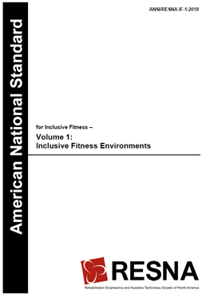
RESNA IF-1:2021 Inclusive Fitness Environments
Section 1: Providing and Marketing Inclusive Fitness Environments

Slide 44
RESNA IF-1:2021 Inclusive Fitness Environments
Section 2: Disclosure of Published Methods and Requirements for Creating Inclusive Fitness Environments and Implementing Inclusive Fitness Practices
Policy
Facility
Equipment
Programming
Staff/trainers
Users/consumers

Slide 45
RESNA IF-1:2021 Inclusive Fitness Environments
Section 3: Specifications, Test Methods, and Best Practices for Facility Accessibility
Includes fitness equipment scoping for existing and new facilities

Slide 46
Draft RESNA IF-1 Inclusive Fitness Environments
Section 4: Specifications for Training and Certification for Working with People with Disabilities for Community-Based Fitness Facility Staff
Trainers and staff
University curriculum

Slide 47
Draft RESNA IF-1 Inclusive Fitness Environments
Section 5: Guidelines for Disclosure of Information about Adherence to Best Practices Related to Inclusive Fitness Environments for Marketing Purposes
What do people need to know?
How do they want to get the information?
Users survey under development

Slide 48
Draft RESNA IF-1 Inclusive Fitness Environments
Section 6: Policies
So new, the full title is still to be drafted
Best-practice policies
Benefits of hiring people with disabilities

Slide 49
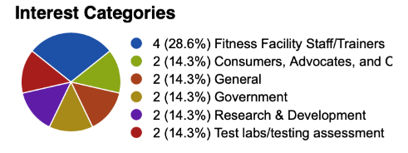
RESNA IF Experts Needed
Fitness equipment manufacturers
Academic researchers
Application and standards order form: https://www.resna.org/AT-Standards/Inclusive-Fitness-IF
Email: stephanie@beneficialdesigns.com

Slide 50
Acknowledgements
The contents of this project were developed by RERC RecTech under a grant from the National Institute on Disability, Independent Living, and Rehabilitation Research (NIDILRR grant numbers—H133E120005 and 90REGE0002). NIDILRR is a Center within the Administration for Community Living (ACL), Department of Health and Human Services (HHS). The contents of this presentation do not necessarily represent the policy of NIDILRR, ACL, HHS, and you should not assume endorsement by the Federal government.

Slide 51
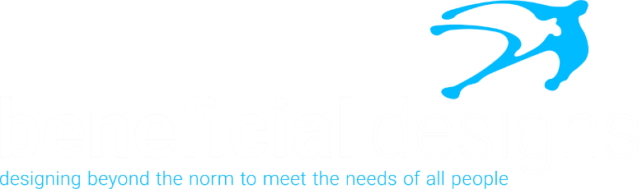
www.beneficialdesigns.com
mail@beneficialdesigns.com
775 783 8822 voice
775 201 8850 fax

Slide 52
Next presenter…

Slide 53
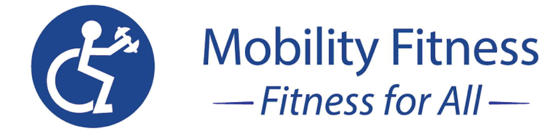
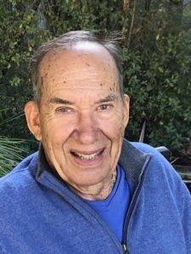
Mobility Fitness
richard@mobilityfitness.org
https://mobilityfitness.org

Slide 54
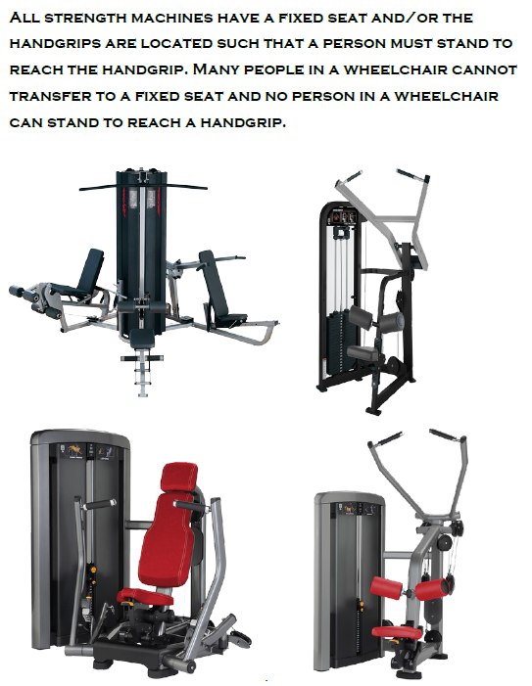
Strength

Slide 55
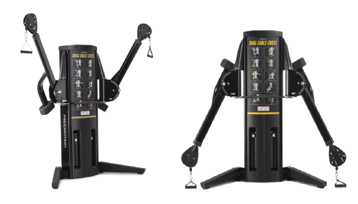
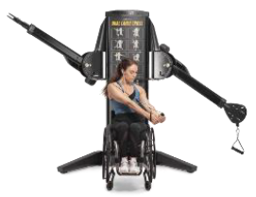
FreeMotion DUAL CABLE CROSS
The FreeMotion dual cable cross machine is the only strength machine that allows a user in a wheelchair to perform numerous exercises. It is widely used and has been in existence for over 20 years.
FreeMotion is currently upgrading the product to comply with the ASTM inclusive standards.

Slide 56
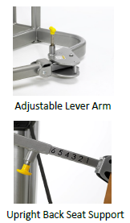
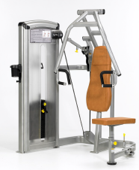
VR3 Total Access Chest Press
Key Features
Locking Plunger Adjustment
Locking Plunger Adjustment on swing away seat allows easy access for wheelchairs users and one-handed seat adjustment for users with limited mobility
Adjustable Lever Arm enables a non-stressed start position for users with limited shoulder flexibility and wheelchairs users
Upright Seat Back Support (10°) allows wheelchair users to maintain stability with heavier weights
Integral 3-position Twist Select mechanism offers ease of weight selection from seated exercise position
Top Mounted Exercise Pivot Position ensures correct biomechanical chest press movement from the hinged lever arm pivoting at the top
Choice of Upper and Lower Handle Positions which caters for wheel-chair users, shorter users and those with balance problems
Weight Stacks with Low Start Weights and 2.5kg Increments suitable for inexperienced and older users
Twist Select

Slide 57
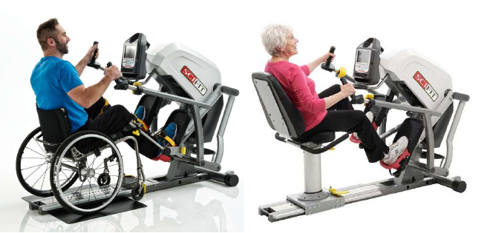
SCIFIT STEPPER
A good example of a recumbent cardio machine where the arms move the legs, and the seat can be
removed so that it can be operated from a wheelchair. Unfortunately, Life Fitness has no plans to add the ASTM audible features.

Slide 58
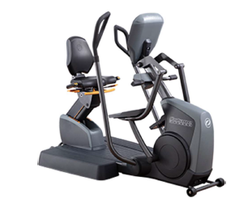
OCTANE RECUMBENT ELLIPTICAL
True Fitness recently purchased Octane. It plans to have the seat separated like the SCIFIT Stepper and add the audible feature to make the product ASTM compliant.

Slide 59
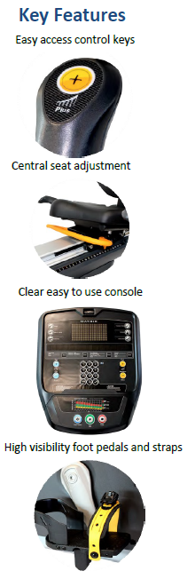

R3x-U Recumbent Cycle
Provides an effective cardiovascular exercise
Step-through design ensures easy access
Low impact exercise
Clear and central seat adjust, tactile seat number positioning
Clear and easy to use tactile console control keys, program indicators, numbers & icons
Fully supportive, highly visible pedals and straps.
Raised tactile quick / adjustment keys

Slide 60



Total Access - Treadmill Model 750T IFI
Multiple belt logos ensure that one logo is always completely visible at all times so that visually impaired and other users can recognize if the belt is moving
Raised console iconography and color allows easy identification of the main controls both by color, large buttons and text for older users, plus raised iconography for visually impaired users
Emergency kill cord switch provides safe emergency stop for users with limited upper limb function
Running deck and belt color contrast. An important feature for users to be able to determine whether the belt is moving from the static side rails

Slide 61
Next presenter…

Slide 62


UAB Title slide
U.S Access Board
Moving Forward: Access to Inclusive Fitness Equipment
Research to support the effort

Slide 63


Presenters
Left- Beth Barstow PhD, OTR/L, SCLV, FAOTA
Associate Professor, Program Director Graduate Certificate in Low Vision Rehabilitation
Occupational Therapy Department UAB
Right- Sangeetha Padalabalanarayanan, MS
Program Director, RERC RecTech, UAB/Lakeshore Research Collaborative
Secretary, RESNAIF Committee

Slide 64
Table of contents
How research facilitated ASTM and RESNAIF process?
Barriers and facilitators on using standards
Mapping system to locate accessible physical activity resources in the community
Evaluation tools

Slide 65

Disclaimer
Disclaimer:
The contents of these projects were developed by RERC RecTech under a grant from the National Institute on Disability, Independent Living, and Rehabilitation Research (NIDILRR grant numbers- H133E120005 and 90REGE0002). NIDILRR is a Center within the Administration for Community Living (ACL), Department of Health and Human Services (HHS). The contents of this presentation do not necessarily represent the policy of NIDILRR, ACL, HHS, & you should not assume endorsement by the Federal Government.

Slide 66
Previous Research
Barstow, B. A., Vice, J., Bowman, S., Mehta, T., Kringen, S., Axelson, P., & Padalabalanarayanan, S.
(2019). Examining perceptions of existing and newly created accessibility symbols. Disability and
Health Journal, 12(2), 180-186.
Vice, J., Barstow, B. A., Bowman, S., Mehta, T., Kringen, S., Axelson, P., & Padalabalanarayanan, S.
(2020) Effectiveness of the international symbol of access and inclusivity of other disability groups,
Disability and Health Journal, 13, doi.org?10.1016/j.dhjo.2019.100836

Slide 67
Current Project Aims
AIM 1- To determine the barriers and facilitators for producing accessible fitness equipment
What do product manufacturers perceive as the primary issues associated with manufacturing UD fitness equipment? Accessible fitness equipment is defined as products that meet the ASTM UDFE standards.
AIM 2- To determine the barriers to and facilitators for designing accessible pubic and private fitness facilities in the context of programming, services, and environments.
What do fitness facility personnel perceived as the primary issues associated with designing accessible fitness facilities. An accessible facility is defined as meeting the RESNA National Guidelines for Inclusive Fitness.
AIM 4- To compare and contrast the perceptions of equipment manufacturers and fitness facility personnel to the priorities given by individuals with disabilities regarding UD features.
What driver diagram best describes the aggregate views of individuals, equipment manufacturers and fitness facility personnel for illustrating how UD principles can be applied to enhance accessibility of recreation and fitness facilities, programs, & services.
AIM 3- To assess the relative importance of criteria and “trade-offs” individuals with disabilities would make when prioritizing UD features in public and private fitness facilities.
Which UD features should manufacturers prioritize for adoption & how should they estimate the differences in priority weights of UD features between subgroups of individuals with disabilities.

Slide 68

PHASE 1
We completed qualitative interviews of 8 national/international equipment manufacturers
Perceived barriers and facilitators to manufacturing accessible fitness equipment.
The results themed into 1) Challenges and 2) Tipping the scale.

Slide 69
PHASE 2
Interviewed 6 fitness facility personnel
Perceptions of universal design and accessible programming, equipment and space
All 6 reported
Lack of funding to implement programming, train staff and purchase accessible equipment

Slide 70
PHASE 3
Interviewed 8 individuals
Perceptions of universal design and accessible programming, equipment and space
Very preliminary findings indicate the type of accessible equipment desired and a strong preference for staff training. Many feel that an affordable trainer who is skilled in adapting physical activity, is the most important component of a gym membership

Slide 71
Activity Inclusion Mapping System (AIMS)
Early prototype-proof of concept
Geotagged, crowdsourced mapping system to identify accessible and usable community-based resources
Off-the-shelf open-source product
Resources mapped for two counties in Alabama

Slide 72

AIMS- Features

Slide 73

AIMS Features

Slide 74




Accessible Camping

Slide 75

Oak Mtn. State Park

Slide 76

AIMS- Reviews based on accessibility

Slide 77

AIMS

Slide 78

AIMS Accessibility

Slide 79

AIMS Usability

Slide 80
RecTech Current Cycle
Proof of product- RecTechmatch
Person-centered approach
10 end users/5 trainers
Interview takeaways
Home based exercising
Access to trainers
Product status:
Completion of renewed product
Pilot testing
Launched through NCHPAD website
Include RESNAIF and ASTM certified facilities/products

Slide 81


Assessment Tools

Slide 82
AIMFREE
2017 Apr;10(2):214-221.
doi: 10.1016/j.dhjo.2016.12.011. Epub 2016 Dec 30.
Fitness facilities still lack accessibility for people with disabilities
James H Rimmer ¹, Sangeetha Padalabalanarayanan ², Laurie A Malone ³, Tapan Mehta ⁴
Affiliations
PMID: 28143707
DOI: 10.1016/j.dhjo.2016.12.011

Slide 83
Contact us
Barstow (205)934-7321; Padalabalanarayanan (205) 975-0550
1720 3rd Avenue South, Birmingham AL 35022
bbarstow@uab.edu ; Sangee@uab.edu
Website: https://www.rectech.org

Slide 84
Thank you!

Slide 85
QUESTIONS?
You may type and submit questions in the Q&A Area

Slide 86
Next presenter…

Slide 87
Panel 3 Implementation of Inclusive Fitness Equipment
Gus LaZear
Ability 360
Catherine Carty
UFIT / UNESCO Chair for Inclusive Fitness
Jon Walker and Lloyd Reese
Playcore
Ileana Rodriguez
I Design Access, LLC

Slide 88

Gus LaZear

Slide 89
Universal fitness

Slide 90
Amenities Memberships Membership Classes Recreation Therapy Personal Training Youth Aquatic Military Seniors Sports Rentals

Slide 91
Ability360 Sports & Fitness Center Partners
Ability360 Center Partners
Rehabilitation Facilities
Disability Organizations
Universities
Local Teams and other Sports Organizations
K-12 Schools
Military Organizations
Community Organizations

Slide 92
Universal Fitness Has to be your culture Listen to your members and your community There is not a one size fits all Pilot programs Do what you say you are going to do Maintain member trust

Slide 93


Equipment

Slide 94


Equipment

Slide 95


Equipment

Slide 96


Equipment

Slide 97


Equipment

Slide 98
Universal Fitness
Starts with your culture
Always educating
Always learning
Always listening
Members
Staff
Community

Slide 99
gusl@ability360.org
Gus LaZear – Vice President – Operations & Sports & Fitness

Slide 100
Next presenter…

Slide 101



US Access Board Inclusive Fitness Event
July 14th 2021
UNESCO Chair Project Manager

Slide 102



Universal Fitness Innovation and Transformation www.justdoUFIT.com

Slide 103
Women with Disabilities
93%
It is significant that the deconditioning and loss of function experienced by persons with disability due to inactivity impacts more on quality of life and health than the presenting disability
Women with disabilities are inactive at levels that promote health
Individuals with disabilities are
3 times less active
than persons without disabilities
Children with disabilities are
4.5 times less active
than their peers without disabilities

Slide 104





UFIT continued
1
Lead from the top
Fitness Sector
2
Drive a global social change movement
Intrasectoral & multidisciplinary collaboration
3
4
Innovative capacity building program
5
Over 200 UFIT operators worldwide

Slide 105






Global Impact
Sectoral Impact
Fitness Federations
Manufacturers
Register of Exercise Professionals
Fitness Training Providers
Fitness clubs
Disability service providers

Slide 106
UFIT IMPACT (cont.)
“I am impacted on the way I view UFIT on a level of continuing to enrich the population I truly enjoy working with. I am impacted on the value of this program more now than when I took the training”.
UFIT Fitness professional
UFIT Impact
Fitness Professionals
UFIT Clubs
UFIT Participants
Clubs benefited from:
Professional education and lifelong training;
The development of inclusive policies;
Creation of inclusive fitness environments to democratise access to health and wellbeing to all citizens, including those with disabilities
The clubs find great value in the UFIT brand
Participants improved not only their physical wellbeing but also their social and emotional skills. The impact of this intervention went beyond the health clubs and fitness centres.
All participants named their trainers as a key component
Participants reported positively on their intention to continue working out at their fitness centre.
Increase of self-efficacy
They highly valued their knowledge acquired around ways to adapt exercises for people with disabilities & exercise planning and programming for people with disabilities.
Significant positive impact on staff morale, development and retention was cited.

Slide 107

Contact Information
Visit
www.justdoufit.com
http://www.sportandhumanrights.unescoittralee.com/
Contact:
catherine.carty@mtu.ie

Slide 108
Next presenter…

Slide 109


Playcore Presenters
Jon Walker
Product Manager – Freestanding Play & Fitness
150 PlayCore Drive
Fort Payne, AL 35967
jon.walker@gametime.com
Lloyd Reese
VP Technical Product Management
544 Chestnut Street
Chattanooga, TN 37402
lloyd.reese@playcore.com

Slide 110

Exercise equipment

Slide 111

“Accessible to and Usable by”
Achieving “program access” is well beyond that of physical access
Fitness spaces may meet the minimum standards, but users with disabilities may still have nothing to do and very little equipment to use
Designing a fitness environment to be “accessible to and usable by” all persons with disabilities, may require going beyond the minimum

Slide 112

Development Partnership and Use Studies
Worked with Development Partners:
This led to:
Rick O’Rear - Recreation Division Manager at City of Chattanooga
Christopher Noel - Accessibility Coordinator at New York City Parks
An increased understanding of how to apply the data and metrics to function of the activity.
Discovery of the need for Universal Designs that allow people with or without disabilities to exercise together
Need for improved paths of travel and access for persons in a mobility device

Slide 113

Function and Requirements
Implemented back support on Universally Designed products for the user’s chair to rest against
Added additional handhold variations to allow for additional muscle group engagement
Raised Accessible Chin-Up Bar height to go beyond average reach range and allow for user’s ability to achieve full arm extension

Slide 114

Adjustments to Existing
Raised Accessible Chin-Up Bar height to go beyond average reach range and allow for user’s ability to achieve full arm extension

Slide 115


Accessible Industry Standards
Worked with Development Partners:
Available and Accessible to everyone
Increase social engagement / promote friendships
Christopher Noel - Accessibility Coordinator at New York City Parks
Mt. Sinai Hospital in NYC

Slide 116
Therapeutic Options
Developed a grouping of products to focus on low impact and reach range activities
Implemented soft and textured surfaces to assist with grip
Designed an ergonomic comfort seat with additional support

Slide 117


Validation and Research
Dr. Michael Suk, M.D., J.D., MPH
Chairman of Orthopedic Surgery, Geisinger Health System, Danville, PA
Former White House Fellow-US Department of the Interior, Healthier US Initiative
Author of numerous scientific articles
Former Senior advisor to National Park Service
Dr. Gary Liguori, Ph.D.
Dean of the College of Health Sciences, University of Rhode Island
American Association of of Health and Disability Board Member
Scientific Advisory Board Chair-GOfit
Senior Editor first edition ACSM Guidelines for Exercise Testing and Prescription
Dr. Thom McKenzie, Ph.D.
Emeritus Professor of Exercise and Nutritional Sciences, San Diego State Univ.
Former Adjunct professor, Dept of Pediatrics, University of California, San Diego
Author of over over 200 published papers
Investigator on 14 multidisciplinary research projects-National Institute for Health

Slide 118

Universal Design
Accessible equipment designs are usable and functional for persons with or without disabilities

Slide 119





Well Rounded Exercise Program
Core
Balance
Braces spine and improves efficiency of upper & lower body movement. Promotes balance and stability. Improves functional fitness and and movement in everyday tasks
Reduce risk of falls, improves coordination, overall athletic skill, and posture. Promotes kinesthetic awareness. Increases all-over tone and control when moving body mass over a changing base of support.
Aerobic
Muscle
Flexibility
Utilizes large muscle groups and increases heartrate. Engages heart, lungs, blood vessels, improving efficiency.
Increases bone strength, boosts metabolic rate, slows or reverses age-related muscle loss. Has a beneficial effect on cognitive ability, insulin sensitivity, and depression.
Improves range of movement, joint motion, and posture. Relieves stress, improves feelings of well-being. Reduces post exercise soreness while improving physical performance.

Slide 120



Equipment Benefits

Slide 121

Space Typologies

Slide 122





Product Selection
Worked with New York City Parks to select a grouping of approved Accessible Outdoor Fitness Products to be included in future projects

Slide 123

Accessible Routes
ASTM F3101-15 states “Outdoor fitness equipment placement shall meet DOJ 2010 Standard for Accessible Design requirements for accessible routes, passage, turning areas and surfacing of applicable standards.”
Worked with Bill Botten to ensure adequate routes of travel to the equipment and mobility device clear spaces are identified for layout.
Implemented CAD blocks and resources for project managers and designers to use when developing spaces.

Slide 124

Final Application

Slide 125

Contact Information and Resources
PlayCore Resources
Questions
core@playcore.com
Request Outdoor Adult Fitness Guidebook
www.playcore.com/programs/outdoor-adult-fitness
Newsletter
www.playcore.com/newsletter
Funding Tool
www.playcore.com/funding
Resources
www.playcore.com/resources
COVID19 Resources
www.playcore.com/COVID-19-play-recreation-resources

Slide 126
Next presenter…

Slide 127


Ileana Rodriguez
Ileana Rodriguez
Cuba- American
Master in Architecture
Paralympic Swimmer – LONDON 2012
Business Owner
Houston Planning Commission
Chef de Mission Refugee Paralympic Team - Tokyo 2020
Athlete Representative for the Americas Paralympic Committee

Slide 128
Idesign graphic of the USA.
_{*Image by IDesign Access}

Slide 129

Accessibility + Design = Inclusion
Olympic and Paralympic Training Center

Slide 130

Ileana Rodriguez
i.Rodriguez@idesignaccess.com
(305) 322 0900

Slide 131
QUESTIONS?
You may type and submit questions in the Q&A Area

Slide 132
Next presenter…

Slide 133
Thank you for Joining us today.
This concludes our event. This event has been recorded and the recording will be available on the Access Board’s homepage and its YouTube Channel soon.

Slide 134
Meeting of the U.S. Access Board will resume with regular business at 3:30 p.m. ET

Slide 135


Moving Forward: Access to Inclusive Fitness Equipment

